Slide 1
Conceptual Dependency
Lecture Module 17

Slide 2
Conceptual Dependency (CD)
CD theory was developed by Schank in 1973 to 1975 to represent the meaning of NL sentences.
  It helps in drawing inferences
  It is independent of the language
CD representation of a sentence is not built using words in the sentence rather built using conceptual primitives which give the intended meanings of words.
CD provides structures and specific set of primitives from which representation can be built.

Slide 3
Primitive Acts of CD theory
ATRANS Transfer of an abstract relationship (i.e. give)
PTRANS Transfer of the physical location of an object (e.g., go)
PROPEL Application of physical force to an object (e.g. push)
MOVE Movement of a body part by its owner (e.g. kick)
GRASP Grasping of an object by an action (e.g. throw)
INGEST Ingesting of an object by an animal (e.g. eat)
EXPEL Expulsion of something from the body of an animal (e.g. cry)
MTRANS Transfer of mental information (e.g. tell)
MBUILD Building new information out of old (e.g decide)
SPEAK Producing of sounds (e.g. say)
ATTEND Focusing of a sense organ toward a stimulus
(e.g. listen)

Slide 4
Conceptual category
There are four conceptual categories
  ACT Actions {one of the CD primitives}
  PP Objects {picture producers}
  AA Modifiers of actions {action aiders}
  PA Modifiers of PP’s {picture aiders}

Slide 5
Example
I gave a book to the man. CD representation is as follows:
P O R man (to)
I ⇔ ATRANS ← book
I (from)
It should be noted that this representation is same for different saying with same meaning. For example
  I gave the man a book,
  The man got book from me,
  The book was given to man by me etc.

Slide 6
Few conventions
Arrows indicate directions of dependency
Double arrow indicates two way link between actor and action.
O – for the object case relation
R – for the recipient case relation
P – for past tense
D - destination

Slide 7
Some of Conceptualizations of CD
Dependency structures are themselves conceptualization and can serve as components of larger dependency structures.
The dependencies among conceptualization correspond to semantic relations among the underlying concepts.
We will list the most important ones allowed by CD.
Remaining can be seen from the book.

Slide 8
Rule 1: PP ⇔ ACT
It describes the relationship between an actor and the event he or she causes.
  This is a two-way dependency, since neither actor nor event can be considered primary.
  The letter P in the dependency link indicates past tense.
Example: John ran
P
CD Rep: John ⇔ PTRANS

Slide 9
Rule 2: ACT ← PP
It describes the relationship between a ACT and a PP (object) of ACT.
  The direction of the arrow is toward the ACT since the context of the specific ACT determines the meaning of the object relation.
Example: John pushed the bike
O
CD Rep: John ⇔ PROPEL ← bike

Slide 10
Rule 3: PP ↔ PP
It describes the relationship between two PP’s, one of which belongs to the set defined by the other.
Example: John is doctor
CD Rep: John ↔ doctor

Slide 11
Rule 4: PP ← PP
It describes the relationship between two PP’s, one of which provides a particular kind of information about the other.
  The three most common types of information to be provided in this way are possession ( shown as POSS-BY), location (shown as LOC), and physical containment (shown as CONT).
  The direction of the arrow is again toward the concept being described.
Example: John’s dog
poss-by
CD Rep dog ← John

Slide 12
Rule 5: PP ⇔ PA
It describes the relationship between a PP and a PA that is asserted to describe it.
  PA represents states of PP such as height, health etc.
Example: John is fat
CD Rep John ⇔ weight (> 80)

Slide 13
Rule 6: PP ← PA
It describes the relationship between a PP and an attribute that already has been predicated of it.
  Direction is towards PP being described.
Example: Smart John
CD Rep John ← smart

Slide 14
R → PP (to)
Rule 7: ACT ←
← PP (from)
It describes the relationship between an ACT and the source and the recipient of the ACT
Example: John took the book from Mary
R → John
CD Rep: John ⇔ ATRANS ←
O ↑ ← Mary
book

Slide 15
→ PA
Rule 8: PP
← PA
It describes the relationship that describes the change in state.
Example: Tree grows
→ size > C
CD Rep: Tree ←
← size = C

Slide 16
⇔ {x}
Rule 9:
⇔ {y}
It describes the relationship between one conceptualization and another that causes it.
  Here {x} is causes {y} i.e., if x then y
Example: Bill shot Bob
{x} : Bill shot Bob
{y} : Bob’s health is poor

Slide 17
⇔ {x}
Rule 10: ↓
⇔ {y}
It describes the relationship between one conceptualization with another that is happening at the time of the first.
  Here {y} is happening while {x} is in progress.
Example: While going home I saw a snake
I am going home
↓
I saw a snake

Slide 18
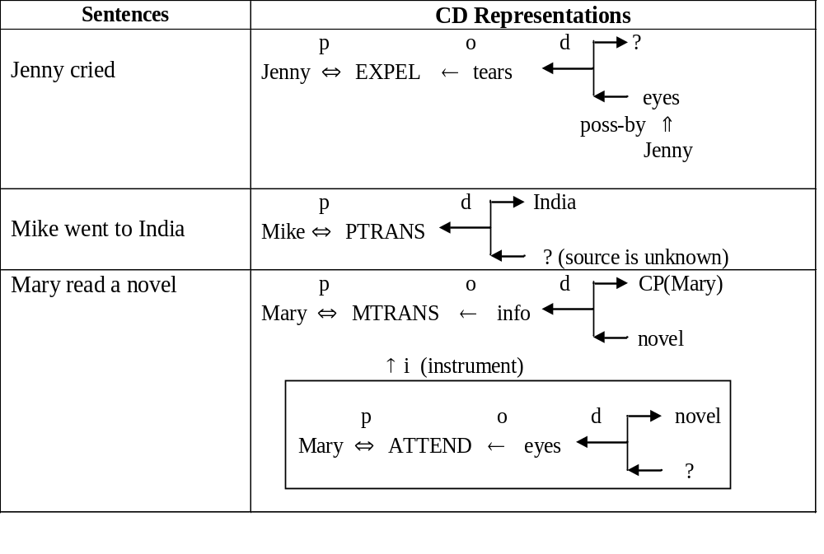
Generation of CD representations

Slide 19
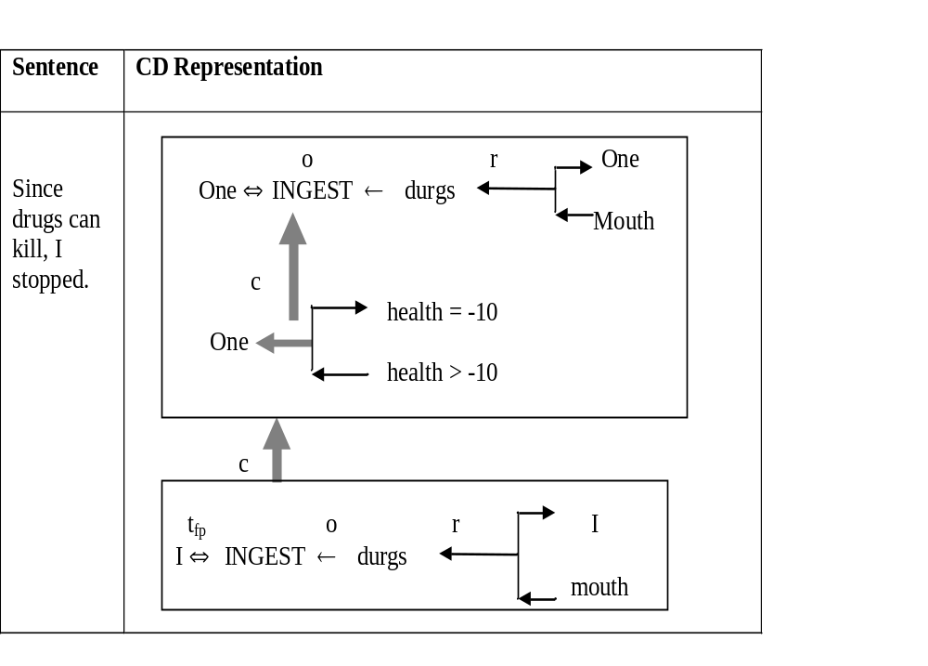

Slide 20
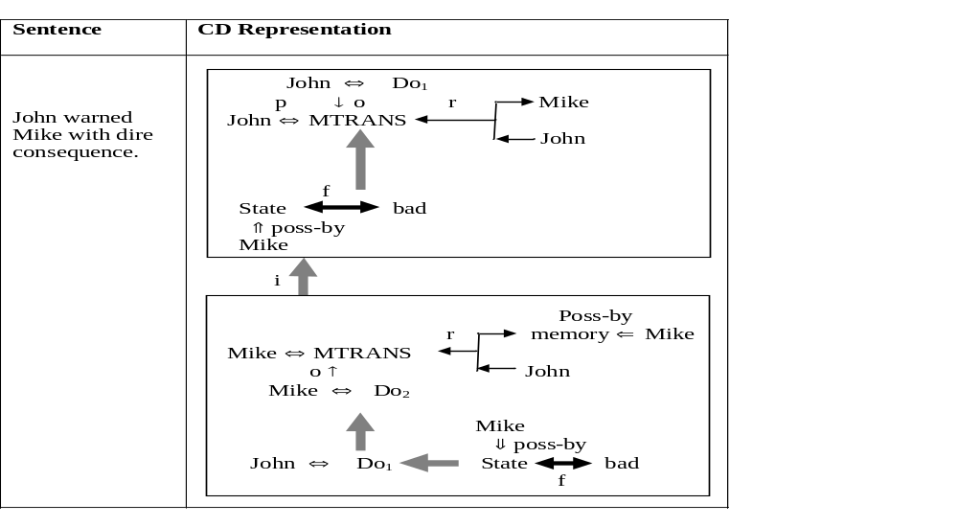

Slide 21
Inferences Associated with Primitive Act
General inferences are stored with each primitive Act thus reducing the number of inferences that need to be stored explicitly with each concept.
For example, from a sentence “John killed Mike”, we can infer that “Mike is dead”.
Let us take another example of primitive Act INGEST.
The following inferences can be associated with it.
  The object ingested is no longer available in its original form.
  If object is eatable, then the actor has less hunger.
  If object is toxic, then the actor’s heath is bad.
  The physical position of object has changed. So PTRANS is inferred.

Slide 22
Cont…
Example: The verbs {give, take, steal, donate} involve a transfer of ownership of an object.
  If any of them occurs, then inferences about who now has the object and who once had the object may be important.
  In a CD representation, these possible inferences can be stated once and associated with the primitive ACT “ATRANS”.
Consider another sentence “Bill threatened John with a broken nose”
  Sentence interpretation is that Bill informed John that he (Bill) will do something to break john’s nose.
  Bill did (said) so in order that John will believe that if he (john) does some other thing (different from what Bill wanted) then Bill will break John’s nose.

Slide 23
Problems with CD Representation
It is difficult to
  construct original sentence from its corresponding CD representation.
  CD representation can be used as a general model for knowledge representation, because this theory is based on representation of events as well as all the information related to events.
Rules are to be carefully designed for each primitive action in order to obtain semantically correct interpretation.

Slide 24
Contd…
Many verbs may fall under different primitive ACTs, and it becomes difficult to find correct primitive in the given context.
The CD representation becomes complex requiring lot of storage for many simple actions.
For example, the sentence “John bet Mike that Indian cricket team will win incoming world cup” will require huge CD structure.

Slide 25
Conceptual Parsing
Conceptual parsing is required for generating CD representation from source sentences in natural language.
The main steps involved in CD parsing are as follows:
  Syntactic processor extracts main verb and noun along with syntactic category of the verb (transitive or intransitive) from the sentence.
  Conceptual processor then makes use of verb−ACT dictionary.
  Once the correct entry from dictionary is chosen, CD processor analyses the rest of sentence looking for arguments for empty slots of the verb.
  CD processor examines possible interpretation in a well-defined order.

Slide 26
Example
Case1: Handling of ‘with PP’ phrase by CD processor and formulating strategies to disambiguate the meanings.
  Type1: John broke the door with hammer non animate
  Type2: John broke the door with Mike animate
Rule 1: If PP in ‘with PP’ phrase is non-animate and CD Act requires instrument then the sentence is of Type1, where PP (hammer) is resolved to instrument.
Rule 2: If PP in ‘with PP’ phrase is animate and CD Act requires instrument then the sentence is of Type2, where PP (Mike) is resolved as co-actor.

Slide 27
Contd..
Case2: If PPs in both the sentences are non-animate, then they have to be resolved using semantic lexicon.
  Type3: John went to the garden with flowers
  Type4: John went to the garden with bag
In Type3, non-animate noun ‘flowers’ is part of garden, whereas in Type4, non-animate ‘bag’ is some object not related to garden.
Such association of word senses could be found in Word-Net and then disambiguation is possible.
Here noun ‘bag’ is treated as possession by John.

Slide 28
Contd..
Case 3: If PPs in the sentences are animate, then they have to be resolved using semantic lexicon and context.
Consider the following examples.
  Type5: John went to the garden with Mike
  Type6: John went to the garden with butterflies
  Type7: John went to the garden with dog
In these sentences, Mike, butterflies and dog are animate PPs and can be resolved as follows:
Mike is easily resolved to co-actor of John as both are human and have similar characteristics.

Slide 29
Contd..
Word-Net can be used to check if butterfly and garden has some common sense.
Dog is still ambiguous.
It may be treated as possession of actor or may be a part of garden as animals many wonder in garden.
Such situations can be further resolved by considering the context of sentences.
We can use semantic lexicon dictionary to resolve some of the ambiguities.

Slide 30
Script Structure
Scripts were introduced by Schank and Abelson introduced in 1977 that used CD framework.
The scripts are useful in describing certain stereotyped situations such as going to theater
It consists of set of slots containing default values along with some information about the type of values similar to frames.
It differs from FS as the values of the slots in scripts must be ordered and have more specialized roles.
In real world situations, we see that event tends to occur in known patterns because of clausal relationship to the occurrence of events

Slide 31
Script Components
Each script contains the following main components.
  Entry Conditions: Must be satisfied before events in the script can occur.
  Results: Conditions that will be true after events in script occur.
  Props: Slots representing objects involved in the events.
  Roles: Persons involved in the events.
  Track: Specific variation on more general pattern in the script. Different tracks may share many components of the same script but not all.
  Scenes: The sequence of events that occur. Events are represented in conceptual dependency form.

Slide 32
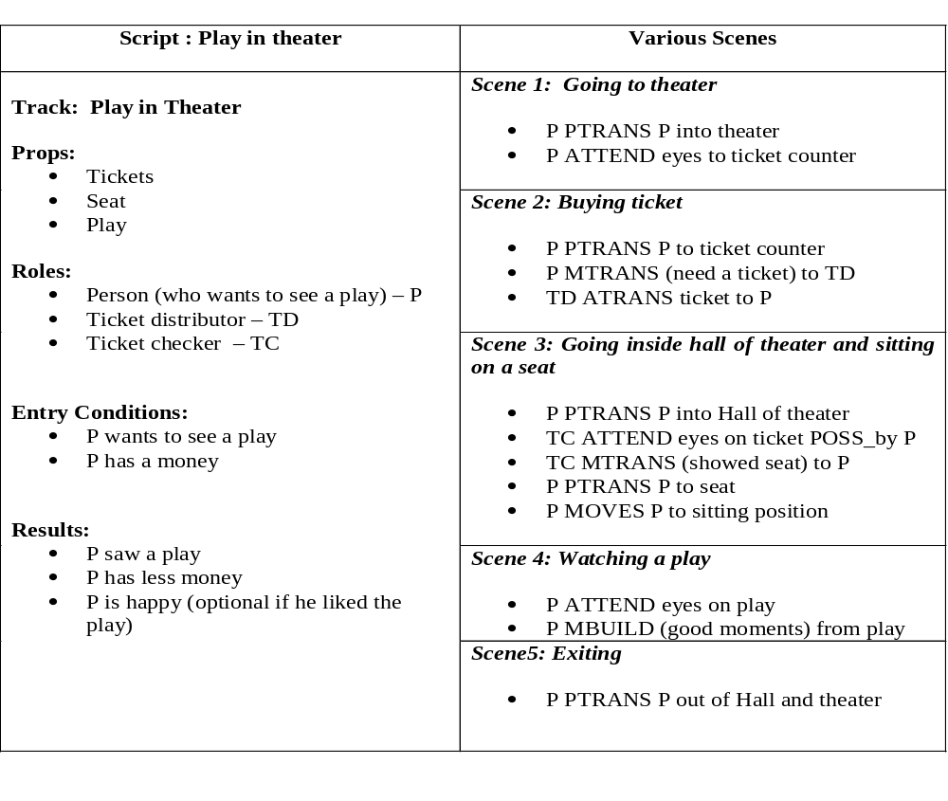

Slide 33
Script Invocation
It must be activated based on its significance.
If the topic is important, then the script should be opened.
If a topic is just mentioned, then a pointer to that script could be held.
For example, given “John enjoyed the play in theater”, a script “Play in Theater” suggested above is invoked.
All implicit questions can be answered correctly.
Here the significance of this script is high.
  Did john go to theater?
  Did he buy ticket?
  Did he have money?
If we have a sentence like “John went to theater to pick his daughter”, then invoking this script will lead to many wrong answers.
  Here significance of the script theater is less.
Getting significance from the story is not straightforward. However, some heuristics can be applied to get the value.

Slide 34
Advantages / Disadvantages of Script
Advantages
  Capable of predicting implicit events
  Single coherent interpretation may be build up from a collection of observations.
Disadvantage
  More specific (inflexible) and less general than frames.
  Not suitable to represent all kinds of knowledge.
To deal with inflexibility, smaller modules called memory organization packets (MOP) can be combined in a way that is appropriate for the situation.

